Slide 1
Cloud Computing in eHealth
Nate Bachmeier
TIM-8101: Principals of Computer Science
April 21st, 2019

Slide 2
Why Cloud Computing?
It is …
Standardized Platform for Provisioning Resources
Scalable and Elastic
Always On / Always Available Networking
Reusable set of language independent primitives
It enables …
Cost savings by economies of scale
Provide services anywhere that has network access
Virtually unlimited resources for any business challenge
Notes:
Cloud Computing provides a standardized way to provision resources, such as storage and compute. These resources are always on and always connected which is great for many business challenges.
Industries such as ehealth can use cloud computing to reduce costs through elastic resource scenarios. For example the billing portal can scale to multiple instances during the day, and contract to a minimal set during the night when most of the customers are asleep.
Another key advantage of cloud computing is the ability to provision resources at virtually any scale. Traditional IT systems required planning and lead time to procure these resources. Instead cloud based solutions can use just in time provisioning to have the desired resources as they are needed.

Slide 3
Consuming Clouds
Private Cloud
Standardized Processes within a data center
Hybrid Cloud
Private cloud which extends into public cloud
Public Cloud
Hardware resources are managed completely by third party
Notes:
A solution does not need to be hosted in Azure or AWS in order to be considered a cloud. Some organizations have invested heavily in their own private data centers or want to retain complete control over every bit. Platforms such as OpenStack or Azure Stack provide a control plane and allow for consistent provisioning of elastic resources on customer owned hardware.
Many private clouds have a need to extend into the public cloud in what are called hybrid clouds. For example a mission critical database might have a replica maintained in the public cloud. If the physical server has issues, then the operations team can fail over to the replica and maintain service continuity. After resolving the scenario usage can be transitioned back to the private server.
Public clouds data centers owned by third parties such as Azure or AWS.

Slide 4
Data in the Public Cloud
HIPAA/HITECH Compliance
Tiered Archival Models
Hot
Warm
Cold/Deep Freeze
Protecting Storage
Encrypted Storage
Vaulted Storage
Requirements for PHI
Public clouds are certified
Authorization Policies
Notes:
While that sounds great, as an ehealth provider I need to be concerned with safety of my data. After all there are regulatory requirements around personal health information.
Major public cloud providers such as AWS and Azure are certified as HIPAA and HITECH data compliant, which means that health information can be stored on their platforms.
These CSPs provide features to protect the data such as encryption in transit and at rest. There is also object level permissions that control authorization of individual files usage.
To further help businesses meet compliance requirements there is also a notion of vaulted storage. A storage vault is created with certain policy, such as cannot be modified or deleted for 7 years. After the vault is created the platform will enforce that policy on behalf of the customer.
A key advantage of hosting data in the cloud is storage tiering. For example a patient that will be in surgery later that day can have their records replicated to multiple physical locations. Then if a data center was taken offline the medical professionals would still have access to the information.
If the records are unlikely to be referenced they can be transitioned to cold storage, similar to tape archives, which is highly durable but may have delays before it is available.

Slide 5
Securing Data in Public Clouds
IAM Policy and Federated Identity
Certificate Services and Hardware Encryption
Direct Connect, IPSec+VPN, and VPC-to-VPC Peering

Slide 6
Common Challenges
Too Broad of Scope
Too Much Tech Debt
Insufficient Maintenance
Cultural Barriers
User Acceptance

Slide 7
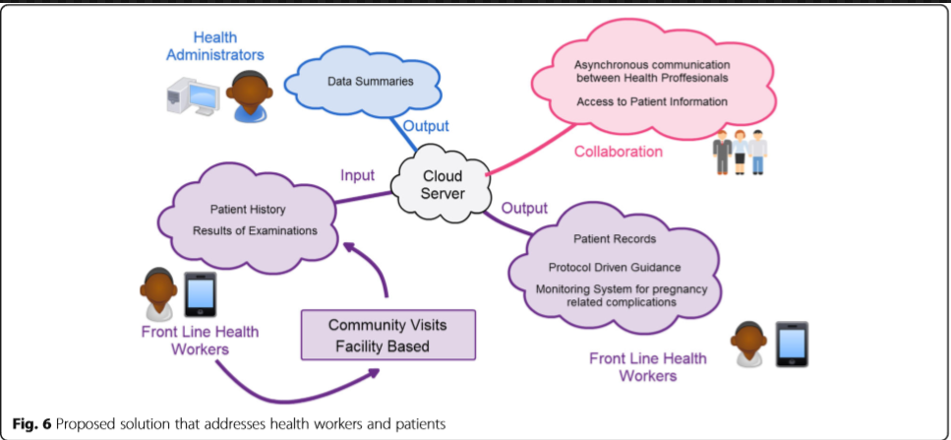
Enabling eHealth in Ghana…
Remote rural locations
Minimal Standardization
High mortality rates
Substandard care

Slide 8
Future of eHealth and Cloud Computing
IoT as a Service
ML as a Service
Notification Services

